Slide 1
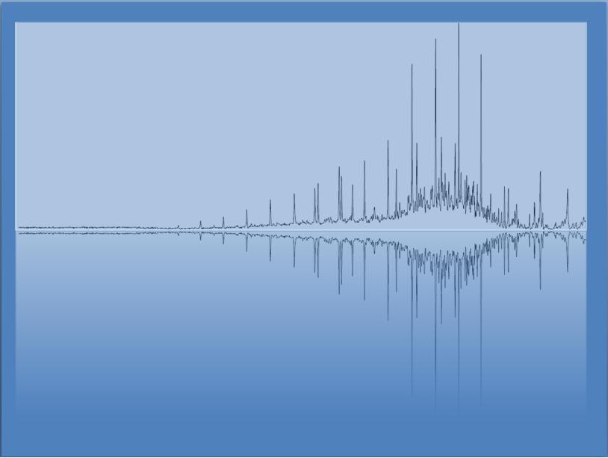
Solutions
Chem 3A- Yates

Slide 2
Outline
You have watched videos on solution definitions (solvent, solute, saturated, etc.)
We have practiced making solutions, calculating molarity and doing dilutions (in lab)
Today
Brief Review- Solubility and Dissociation
Practice Exam

Slide 3
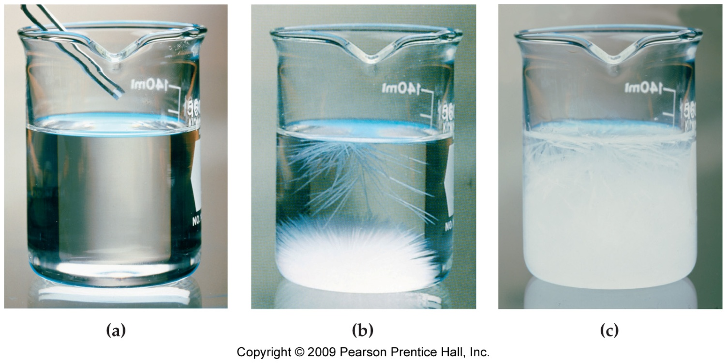
Supersaturated Solution
Heat solution and dissolve as much solute as possible.
-At 100 °C ~160g of NaC₂H₃O₂ can be dissolved in 100 mL of water.
Cool solution carefully, so that solute does not begin to recrystallize.
-At 20 °C ~120g of NaC₂H₃O₂ can be dissolved in 100 mL of water. If the solution is still holding 160 g, it is said to be supersaturated until something causes it to recrystallize.

Slide 4
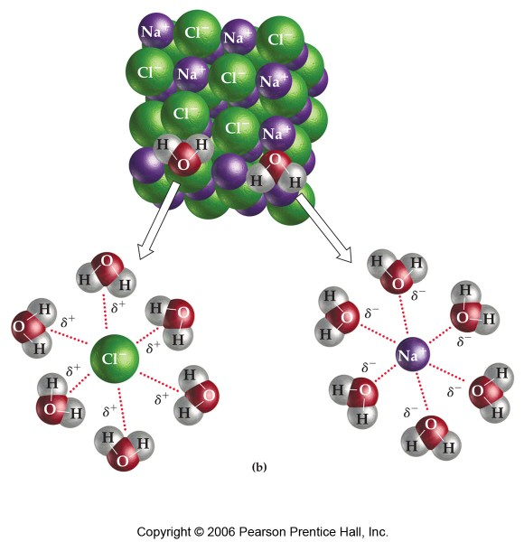
Will It Dissolve?
Chemist’s rule of thumb:
Like dissolves like
*Similar IMFs
*Reminder:
Ionic Compounds may dissolve in polar, hydrogen bonding solvents.

Slide 5
Simple Ionic Compound Solubility Rules (I recommend memorizing these)
Always Soluble
NO₃⁻, Na⁺, K⁺, NH₄⁺
Usually Insoluble
- Combinations of ions > 2+ or 2-
- Ag⁺

Slide 6
Practice—Decide if Each of the Following Will Be Significantly Soluble in Water.
potassium iodide, KI
octane, C₈H₁₈
methanol, CH₃OH
copper, Cu
cetyl alcohol, CH₃(CH₂)₁₄CH₂OH
iron(III) sulfide, Fe₂S₃

Slide 7
Practice—Decide if Each of the Following Will Be Significantly Soluble in Water.
potassium iodide, KI
octane, C₈H₁₈
methanol, CH₃OH
copper, Cu
iron(III) sulfide, Fe₂S₃

Slide 8
Practice—Decide if Each of the Following Will Be Significantly Soluble in Water.
potassium iodide, KI soluble.
octane, C₈H₁₈ insoluble.
methanol, CH₃OH soluble.
copper, Cu insoluble.
iron(III) sulfide, Fe₂S₃ insoluble.

Slide 9
Electrolytes (Ions)
Strong Electrolytes (fully dissociate into ions)
Soluble Ionic
Strong Acids
Weak Electrolytes (partially dissociate)
Weak Acids/Bases
Non-Electrolytes
Molecular Compounds

Slide 10
Molarity and Dissociation
When strong electrolytes dissolve, all the solute particles dissociate into ions.
By knowing the formula of the compound, it is easy to determine the molarity of each dissociated ion.
0.32 M CaBr₂
Ca²⁺
Br⁻
Br⁻
0.32 M Ca²⁺
0.64 M Br⁻

Slide 11
Find the Molarity of All Ions in the Given Solutions of Strong Electrolytes.
0.33 M Na₂CO₃(aq).
0.0750 M Fe₂(SO₄)₃(aq).

Slide 12
Find the Molarity of All Ions in the Given Solutions of Strong Electrolytes, Continued.
Na₂CO₃(aq) → 2 Na⁺(aq) + CO₃²⁻(aq)
0.33 M 0.66 M 0.33 M
Fe₂(SO₄)₃(aq) → 2 Fe³⁺(aq) + 3 SO₄²⁻(aq)
0.0750 M 0.150 M 0.225 M

